Slide 1
Deep Learning for Enhanced Clarity: Revolutionizing Underwater Image Processing
CMP 49413 PROJECT PRESENTATION
Aadhith Shankarnarayanan - b00089801
Ananya Sudheer - g00087186
Vibha Bhavikatti - g00089208
Submitted to: Dr. Omar Arif

Slide 2
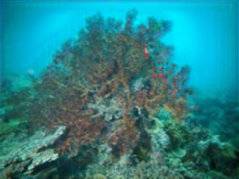
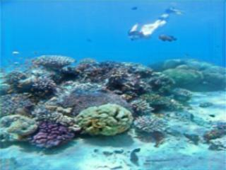
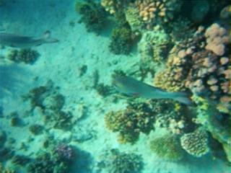
Introduction
Underwater image capturing systems often lack high-resolution capabilities at significant depths.
Challenges such as suspended particles, light refraction, turbidity, low visibility, scattering, and contrast issues degrade image quality.
Achieving high-quality image capture underwater requires expensive equipment.
Deep learning-based approaches show promise in enhancing underwater image quality.

Slide 3
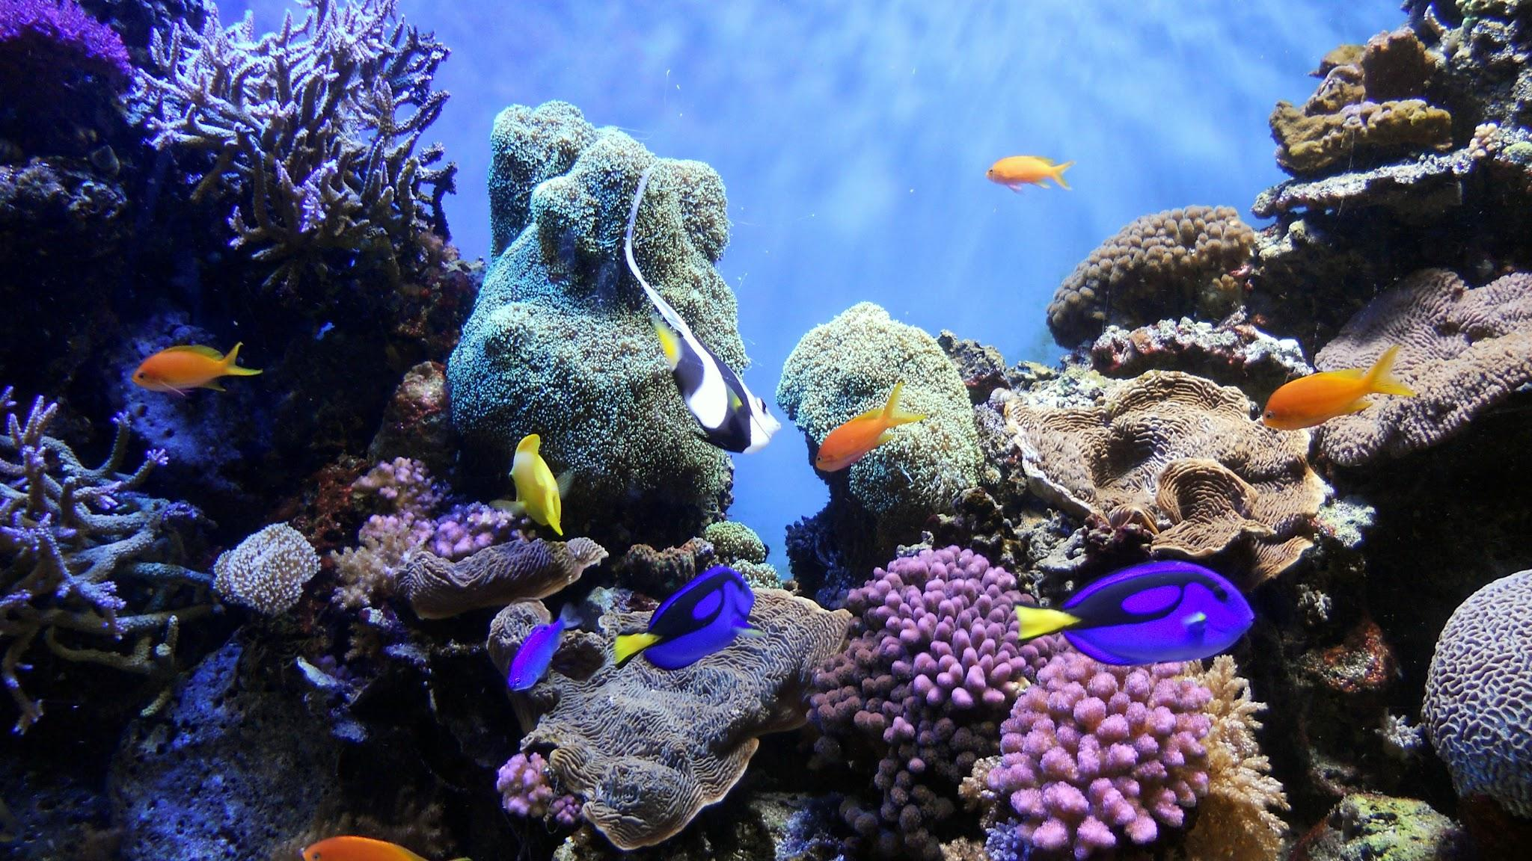
Problem Statement
There is a critical need to develop effective solutions for enhancing underwater image quality to advance research and applications in relevant domains. Despite various proposed algorithms aimed at addressing these challenges and improving image quality, recent advancements in deep learning have demonstrated promising results in this regard.
GOAL:
The main objective is to leverage deep learning models for underwater image restoration, with the objective of benchmarking these results against state-of-the-art techniques and other notable models to further enhance image restoration techniques.

Slide 4
Literature Review
Conditional General Adversarial Networks (CGANs) FUnIE-GAN
EUVP dataset (over 30,000 images)
Based on the U-Net Architecture
Employs a Markovian PatchGAN discriminator
FUnIE-GAN outperforms UGAN-P, Pix2Pix, Uw-HL in quality
Results (UIQM metric)
FUnIE_GAN - 2.78
UGAN-P - 2.72
Pix2Pix - 2.65
Neural Architecture Search (NAS)
U-Net
Proposes NAS-based network consists of an encoder and decoder
3 datasets utilised: EUVP, UIEB, LSUI
Evaluation metrics: Peak Signal to Noise ratio (PSNR) and Structure SIMilarity index (SSIM)
Results:
UIEB
PSNR: 25.45
SSIM: 0.9231
EUVP
PSNR: 29.56
SSIM: 0.8818
LSUI
PSNR: 26.13
SSIM: 0.8608

Slide 5
Literature Review
Conditional Neural Network Regression Model
2 underwater image datasets - U45 (45 images) and UIEB (890 images)
Compared against 8 state of the art techniques
Used metrics like UIQM, UISM, PSNR, SSIM
Results
U45 UIEB
PSNR - 26.967 PSNR - 27.299
SSIM - 0.847 SSIM - 0.793
UIQM - 4.998
Notes:
L. A. Martinho et al. [2] proposes a learning-based restoration approach that uses a combination of deep learning techniques and intensity transformation techniques to restore underwater images. The deep learning technique involves using a CNN Regression model to learn optimal enhancing parameters for various kinds of underwater images and the intensity transformation techniques are applied to raw underwater images to compensate for visual information loss due to underwater degradation, thereby enhancing overall image quality. L. A. Martinho et al. used 2 underwater image datasets - U45 (45 images) and UIEB (890 images) - and also proposed a new challenging dataset AUID comprising 276 underwater images from the Amazon region. The proposed method was compared against 8 state-of-the-art techniques (like VRE, UDCP, IBLA, CBF, GDCP, UWCNN, WaterNet and LI) using metrics like UIQM, UISM, PSNR, SSIM among others. Results indicate that their proposed approach outperforms existing techniques in terms of accuracy as well as visual accuracy. On the U45 and UIEB datasets, their approach achieved PSNR values of 26.967 and 27.299, and SSIM values of 0.847 and 0.793, respectively, surpassing the best comparison techniques. Furthermore, their proposed model also outperformed other models in quantitative metrics with results of UIQM, UISM, UICONM, UICM as 4.998, 5.891, 0.4, 10.735 respectively.

Slide 6
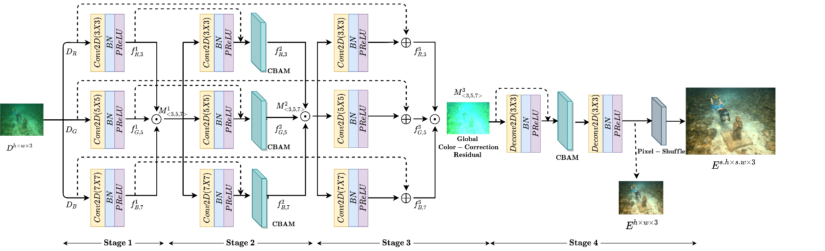
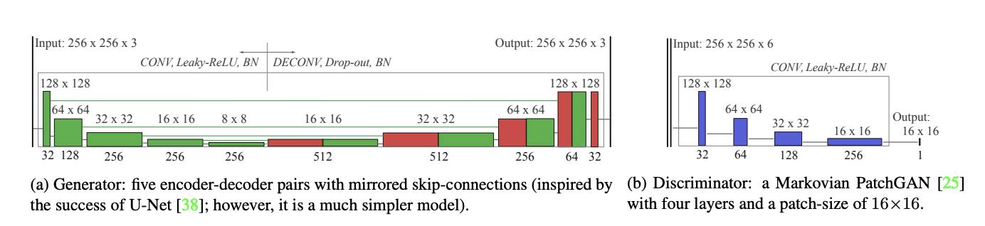
Methodology
Architecture
Deep-WaveNet: Deals with underwater image restoration
FUnIE-GANv2: Provides a competitive performance for underwater image enhancement
Dataset Preparation
Utilizing the EUVP dataset: The Enhancing Underwater Visual Perception Dataset containing separate sets of paired and unpaired image samples.
The test_samples from the EUVP dataset is used for testing purposes.
Model Selection
The network architecture DeepWaveNet is pipelined with FUnIE-GAN to enhance the underwater image restoration and improve the results.
Figure 1: Deep-WaveNet Architecture
Figure 2: FUnIE-GAN Model

Slide 7
Implementation
Here are some points with a bit more detail:
• 3 underwater image sets used: underwater_imagenet, underwater_dark, underwater_scenes
• These sets segregated into trainA (hazy images) and trainB (enhanced/ground truth images)
• Training pipeline:
- First, DeepWaveNet architecture trained on trainA (hazy) images
- Output images from DeepWaveNet stored in MiddleDataset directory
- MiddleDataset then used to train FuNIE-GAN (train.py) for further image enhancement
• Two-stage training process:
- Stage 1: Train DeepWaveNet on hazy images
- Stage 2: Use DeepWaveNet output to train FuNIE-GAN for enhancement

Slide 8
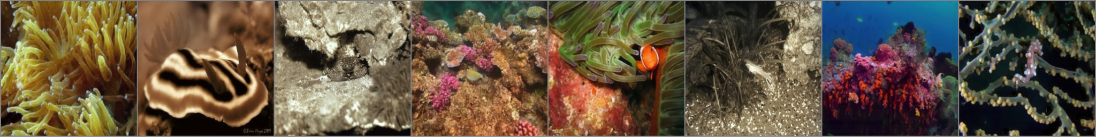
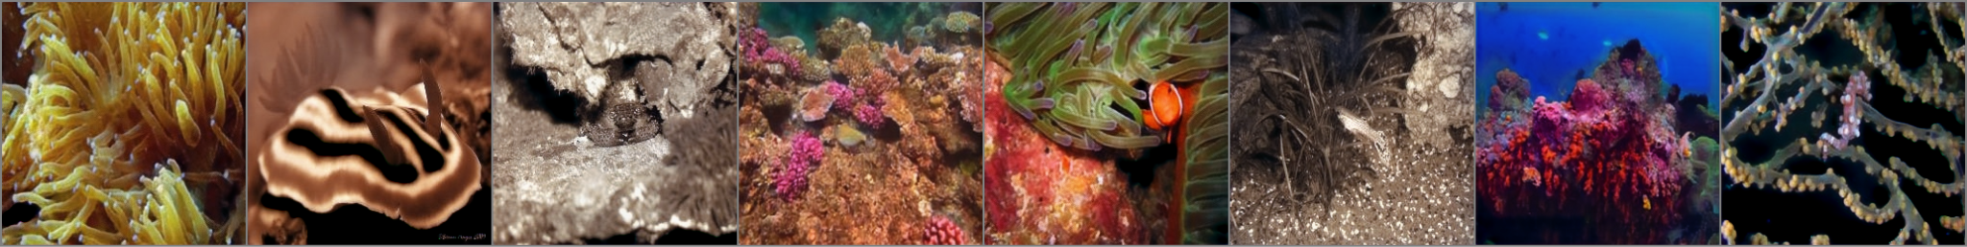
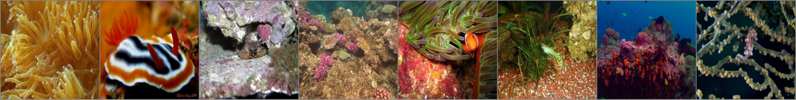
Results
Figure 3: Distorted, Fake (Generated Output), Ground Truth Images Respectively

Slide 9
Performance evaluation
The following evaluation metrics are used to evaluate the results obtained from the combined model:
SSIM:
Measures structural similarity between images
Higher values (closer to 1) = higher similarity
PSNR:
Measures signal-to-noise ratio
Higher values (>30dB) = better quality
UIQM:
Evaluates underwater image quality
Accounts for color cast, blur, low contrast

Slide 10
Discussion
The results upon training and testing are as follows:
TRAINING
The best generator weights/parameter are obtained once the combined model was trained on 11435 samples, giving the results listed below:
SSIM: mean = 0.840, std = 0.086
PSNR: mean = 28.051, std = 3.822
When trained on the 25th epoch generator weights, the model performed really well:
SSIM: mean = 0.838, std = 0.089
PSNR: mean = 28.503, std = 4.021
TESTING (performed on 515 samples)
SSIM PSNR UICM UISM UICONM UIQM
Mean: 0.8394 Mean: 28.2197 Mean: 5.2112 Mean: 6.6808 Mean: 0.2462 Mean: 3.00
std: 0.0596 std: 2.9108 std: 3.2094 std: 1.3495 std: 0.0696 std: 0.4781

Slide 11
Work Division
NAME | CONTRIBUTION
AADHITH SHANKARNARAYANAN | Combined the architecture of DeepWave-Net and FUnIE-GAN Performed the training and testing after combining the model and creating the pipeline of data between the two models Filmed the demonstration video
ANANYA SUDHEER | Worked on the data ingestion (data collection, loading as dataloader for train and test, preprocessing) Presentation
VIBHA BHAVIKATTI | Loading the models and the necessary files for DeepWave-Net and FUnIE-GAN Creating the files for train, test and inference with the pipeline of the two models being combined Presentation

Slide 12
Demonstration

